Slide 1
CodePath
Week 5
CS 4760 F18
Christopher Raley

Slide 2
Codepath Homework
CTF Homework by 10/7 @ 11:59 PM
Including extra credit

Slide 3
Simple Ciphers
Symmetric-Key Algorithms
Public-Key Cryptography
Cryptographic Hash Algorithms
Checksums
Password Hashing
Topics
Week 5
Readings on course website
Discussed in detail in future lectures

Slide 4
Encryption
Encryption is the process of transforming information to keep it private so that only a select few individuals are able to decode it
Note that encoding is just the transferring of data into another format
Result of encryption is ciphertext
This results when plaintext is used as input for some encryption algorithm
Example: 3DES, AES

Slide 5
Shift Ciphers
Shift Cipher - The method to encrypt is to take each character of a message and shift it a certain number of characters to the left or right.
Example: Caesar Cipher (used a shift of 3)
ROT13 - One of the more popular shift ciphers. Shifts letters 13 positions (half of the alphabet)

Slide 6
ROT13 Example
Guvf vf n frperg zrffntr

Slide 7
Substitution Ciphers
Substitution Cipher - Uses a translation map for characters, so that each character in the text gets translated into another character
Substitutions can be completely random
Example:
‘ABCDEFGHIJKLMNOPQRSTUVWXYZ’
‘UMRSQPBOLEXTZYAKJVCNHDWGIF’
Vulnerability?

Slide 8
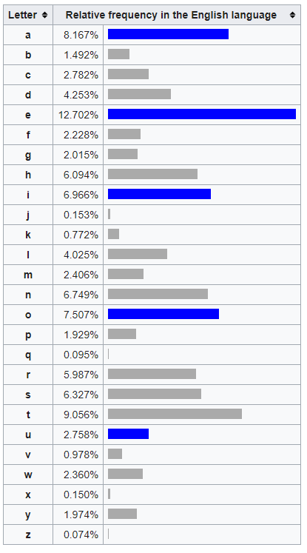
“TO BE OR NOT TO BE”
NA MQ AV YAN NA MQ

Slide 9
Symmetric Key Algorithms
Symmetric-Key Algorithm - Uses a string of data to encrypt and decrypt information
Think of lock and and key situation
This string of data can reverse an an algorithms output so that we get the original plaintext (via mathematical properties)
Problem lies in how exactly do you securely transfer those keys

Slide 10
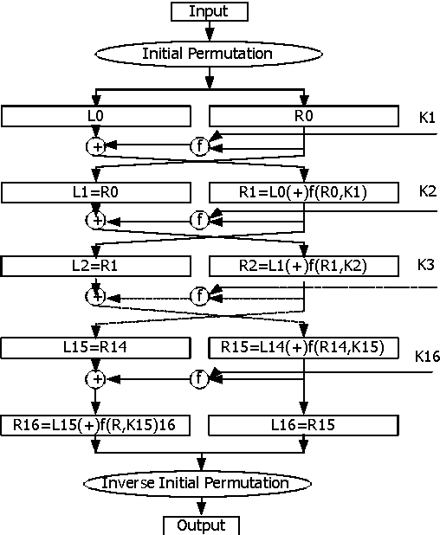

Slide 11
Cryptographic Hash Algorithms
Cryptographic Hash Algorithms - One-way algorithms (extremely difficult to invert output back into original input) that produce checksums.
Examples: MD5, SHA, bcrypt
Used for integrity
Hopefully used for producing hashed passwords
You will commonly find websites that have downloads show a MD5 hash for you to compare to...

Slide 12
MD5 Example
“Hello World!”
ed076287532e86365e841e92bfc50d8c

Slide 13
MD5 Example
“Hello World”
b10a8db164e0754105b7a99be72e3fe5

Slide 14
MD5 Example
ed076287532e86365e841e92bfc50d8c
b10a8db164e0754105b7a99be72e3fe5

Slide 15
CTF Tips
Some challenges require Burp
Make use of online resources
https://www.dcode.fr/xor-cipher
https://www.base64decode.org/
https://cryptii.com/pipes/caesar-cipher
Try writing code to decrypt things for you
Useful for brute forcing

Slide 16
Office Hours
Monday / Thursday / Sunday : 5 - 7 PM @ Rice 226

